Slide 1

Energy Consumption Prediction Using Machine Learning for Smart Buildings.
Optimizing Energy Efficiency for buildings through Machine Learning.
TEAM - A

Slide 2

Buildings consume significant energy, making efficient energy management essential.
Smart buildings optimize energy use, reducing waste, costs, and environmental impact.
Smart technologies enable better energy control through real-time data collection.
Sensors track energy patterns, allowing precise adjustments and proactive optimization.
Data-driven management ensures efficient operations and minimizes energy waste.
Introduction to Smart Buildings

Slide 3

Data Collection
Data is collected from various sensors and IoT devices installed in the building.(Dataset)
Dataset: Hourly electricity and heating consumption from a Malmi office in Helsinki, along with 9 weather features from the nearby Helsinki Malmi Airport station.
Features & Period: Weather variables include temperature, humidity, wind speed, cloud amount, etc., for the period 01/01/2020 to 17/03/2020.

Slide 4
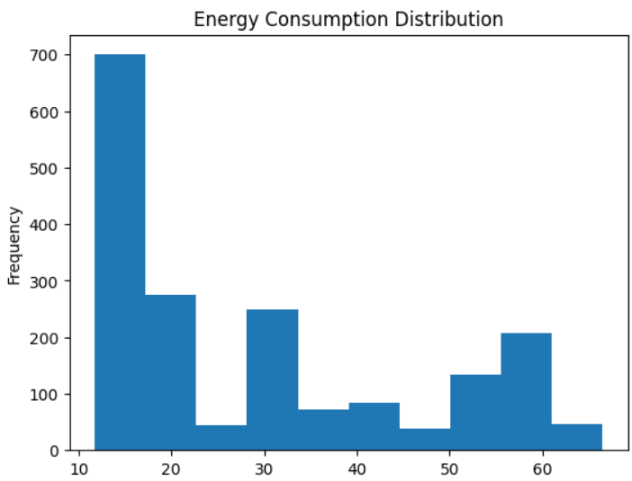
Data Preprocessing
Handling missing values.
Feature engineering: Extracting day names, grouping data by time (daily, weekly).
Resampling the data for daily energy consumption and weather features.
Scaling the data using MinMaxScaler.
Exploratory Data Analysis (EDA)
Distribution of energy consumption (histograms, pairplots).
Visualizing daily and weekly energy consumption.
Correlation analysis: Identifying key features influencing energy consumption.
Feature Selection
Selection of important features for prediction: Heat, temperature, humidity, wind speed, etc.
Analysis of feature importance using correlation.

Slide 5
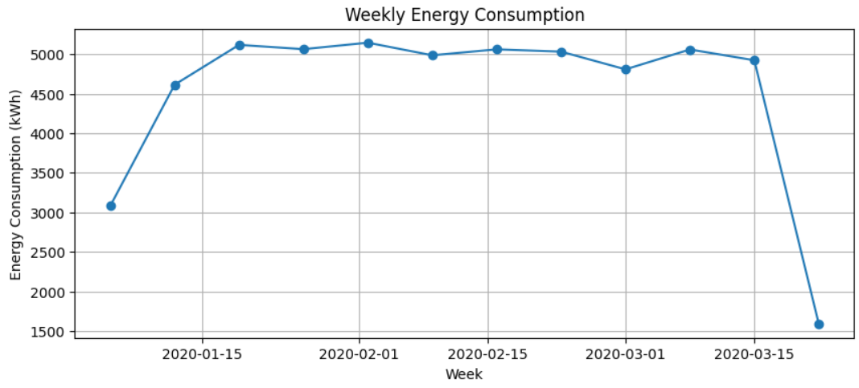
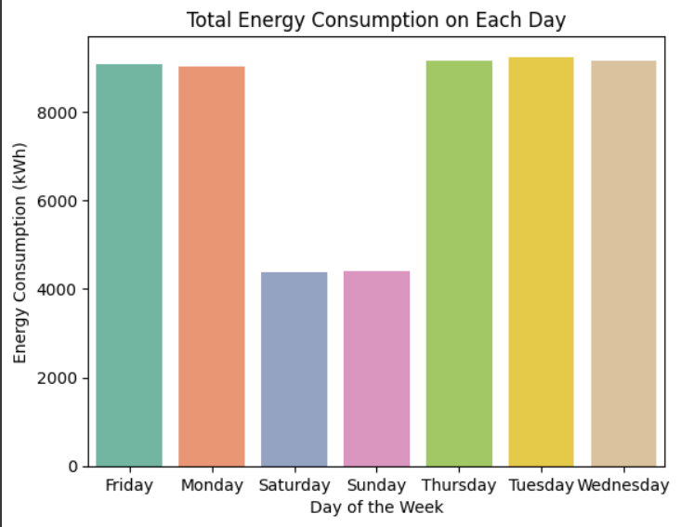
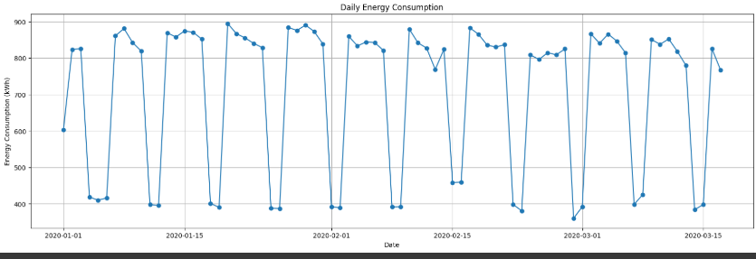

Slide 6

The preprocessed data is used to train machine learning models.
Model Training
Models Used:
1. XGBoost(Extreme Gradient Boosting)
Hyperparameter tuning and evaluation.
2. Support Vector Regression (SVR)
Model performance assessment.
3. K-Nearest Neighbors (KNN)
Model evaluation.
Performance Metrics:
Training Accuracy
Testing Accuracy

Slide 7
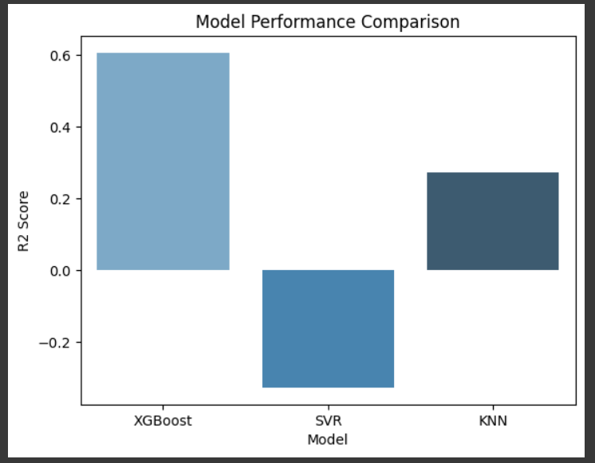
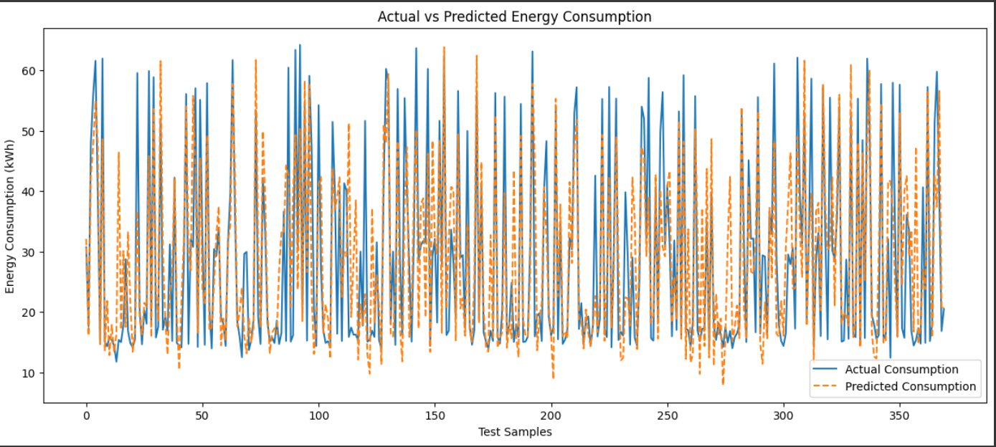
Model Evaluation and Results
Model | Train | Test
XGBoost Model 1 | 0.99 | 0.41
XGBoost Model 2 | 0.89 | 0.64
SVR Model | 0.39 | 0.33
KNN Model | 0.34 | 0.27
Comparison of model performance on training and test data.
Discussion of the best-performing model (XGBoost).
Prediction accuracy and implications for energy management in smart buildings.

Slide 8
Cost Savings
Reducing energy waste leads to lower utility bills, providing significant financial benefits.
Enhanced Comfort
Benefits of Energy Prediction
Adjusting energy use based on occupancy increases occupant satisfaction and comfort levels.
Enhanced sustainability
Decreased energy consumption contributes to achieving environmental sustainability goals.
Informed Decision Making
Predictive analytics aids in making more informed decisions regarding energy management strategies.

Slide 9

Conclusion
Energy consumption prediction is an essential aspect of smart building energy management. By leveraging machine learning techniques and integrating data from sensors and other sources, buildings can optimize energy efficiency, reduce costs, and contribute to sustainability. As technology advances, AI, IoT, and cloud computing will play increasingly important roles in shaping the future of smart building energy management.

Slide 10
Thank you for your time and attention

